Slide 1
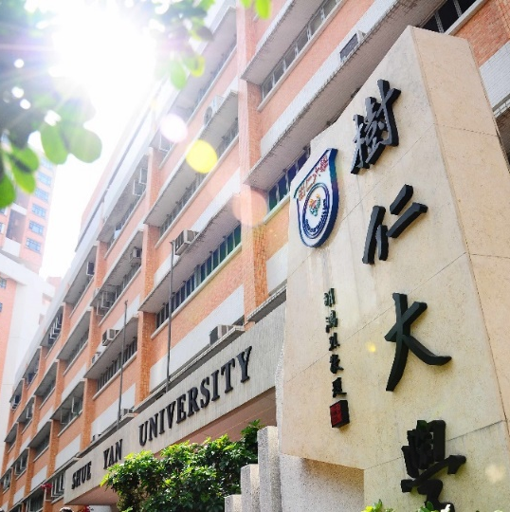
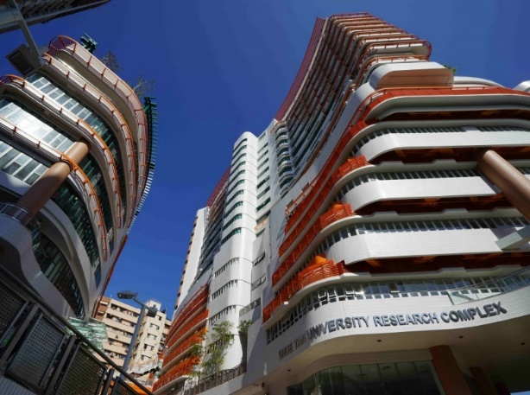
2023-24 年度
二年級同學修科指引
(四年共修125學分畢業)

Slide 2
Second Year |  |  | Credits
Compulsory Courses
Language Requirements: |  |  | 6
ENG. | 211-2 | English Writing
Departmental Core Requirements: |  |  | 12
SOC. | 205 | Sociological Theory I
SOC. | 207 | Sociological Theory II
SOC. | 221 | Social Research Methods
SOC. OR SOC. | 221A 221B | Applied Quantitative Social Research Methods Applied Qualitative Social Research Methods
Departmental Elective Courses* (Choose 6 credits) |  |  | 6
SOC. | 204 | Cultures in the Contemporary World
SOC | 206 | Social Stratification
SOC. | 231 | Social Problems
SOC. | 257 | Art and Society
SOC. | 259 | Race and Ethnicity
SOC. | 260 | Food and Society
SOC. | 261 | Conceptualising Arts and Culture in Modernity
General Education Courses |  |  | 6
Free Elective (Elective courses offered by other departments) |  |  | 6
Total Credits |  |  | 36
*The Departmental Elective Courses offered might be subjected to change.

